Slide 1
Secure your app with JWT
Section Five
Notes:
[Mandatory Slide] This would be the introduction slide of the topic that you are covering in this section.
When this slide plays, you could talk about the main aim that we’d be covering in this section.

Slide 2
Testing Koa endpoints with Postman
Notes:
[Mandatory Slide] This would be the introduction slide of the topic that you are covering in this subsection.
When this slide plays, you could talk about the main aim that we’d be covering in this video.

Slide 3
PostMan
Postman is a collaboration platform for API development. Postman's features simplify each step of building an API and streamline collaboration so you can create better APIs—faster.

Slide 4
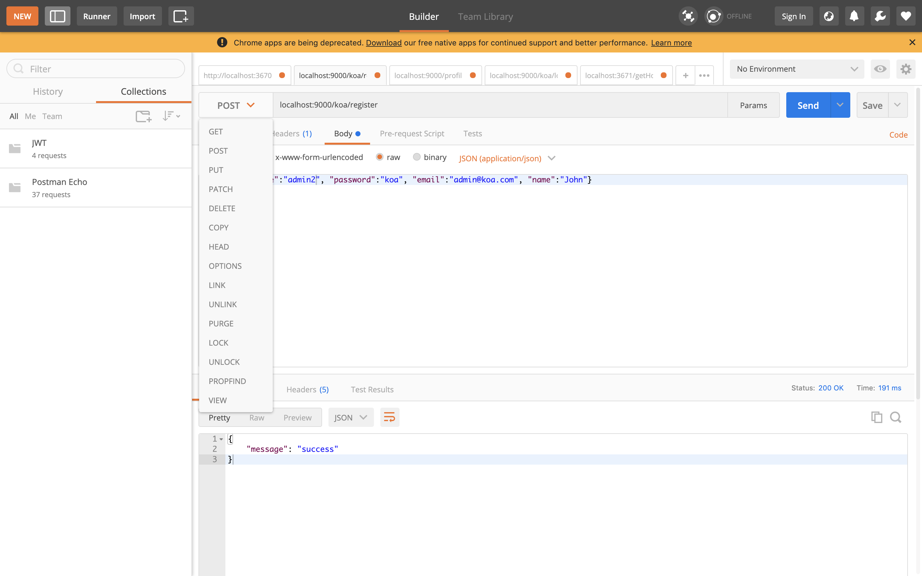
Operations Through PostMan

Slide 5
Hands On
Notes:
This slide, like mentioned above is for multiple pointers. The information above covers the types of information that can be used in this slide

Slide 6
Adding testing Framework
Section Six
Notes:
[Mandatory Slide] This would be the slide of the next video that you will be covering.
When this slide plays, you could talk about the main aim that we’d be covering in the next video.

